Slide 1


Testing

Slide 2


What
Will We
Learn?
JavaScript
?
Testing
Just the facts!

Slide 3
How complex is testing?
JavaScript
Beta testing
Mobile-friendly testing
Change related testing
Security testing
Performance testing
Documentation testing
Functional testing
Usability testing
UI testing
Compatibility (Configuration) testing

Slide 4
Our Focus?
JavaScript
Beta testing
Mobile-friendly testing
Change related testing
Security testing
Performance testing
Documentation testing
Functional testing
Usability testing
UI testing
Compatibility (Configuration) testing

Slide 5


Functionality Testing
JavaScript
Browser accessibility
Check your webpage in multiple browsers
Check Chrome, Firefox, Safari.
Chromium browsers:
Chromium, Chrome, Brave, Edge, Opera, Samsung Internet, Maxthon, Avast Secure Browser, Yandex, Vivaldi, Arc, UC Browser, Puffin
Browsers based on Firefox
Firefox, Waterfox, Mullvad
Independent browsers:
Safari, Tor

Slide 6
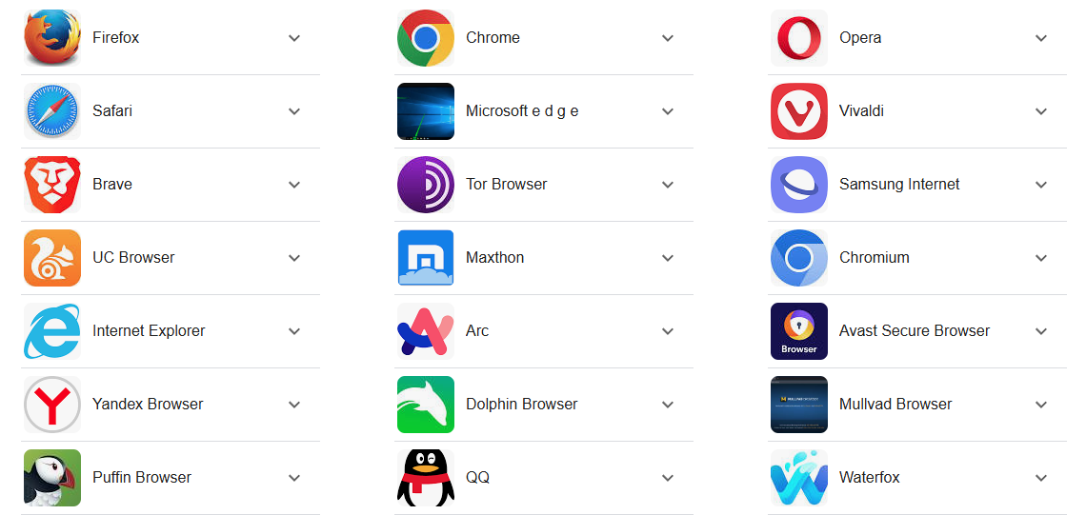
Functionality Testing
JavaScript
Browser accessibility
Check your webpage in multiple browsers
Check Chrome, Firefox, Safari

Slide 7
Functionality Testing
JavaScript
Validation
Check your HTML via the W3C validation service
This checks your HTML document vs the HTML standard
https://validator.w3.org/
Check your CSS via the W3C validation service
This check your CSS file vs the CSS standard
https://jigsaw.w3.org/css-validator/

Slide 8
Functionality Testing
JavaScript
Validation - JavaScript
There are tools we can use to validate JS
We can use Node tools to test JS vs the standards
There are some online tools to test our JS code too.
https://www.site24x7.com/tools/javascript-validator.html
https://esprima.org/demo/validate.html
https://beautifytools.com/javascript-validator.php
https://validatejs.org/
https://validatejavascript.com/

Slide 9
Functionality Testing
JavaScript
Feature Testing
Check your JavaScript functionality
Check that all functions work as expected
Check for invalid inputs
Check for valid inputs
Try to break your app here!
Create a checklist of tests to do.

Slide 10
Accessibility Testing
JavaScript
Testing for Accessibility
Use a checklist for accessibility.
We are testing her against WCAG
https://webaim.org/standards/wcag/checklist
Remember to check for:
Colour contrasts
Logic of your pages
Navigation
Content
How your pages can be read in monochrome or without stylesheets.

Slide 11
Accessibility Testing
JavaScript
Tools
There are tools that can be used
Different websites
Browser addons
Various checklists
Check the useful-links.txt file in Brightspace

Slide 12
UI Testing
JavaScript
Validation
Check your HTML via the W3C validation service
Check your CSS via the W3C validation service
Check your JS via one of the earlier links.

Slide 13
UI Testing
JavaScript
Use Cases
We should create use case diagrams for the system
Document the use cases
Test these use cases and record the results
Refer to week 6 for use case diagrams

Slide 14
Testing
JavaScript
Final Notes
There is a template on Brightspace
This is what you would use:
To list your tests
Record the results
Remember that failing a test is ok
It just tells you that you need to fix something
Then test again.
Record the retest again.

Slide 15
Using the template
JavaScript
Filling out the template
Test Case ID:
The Number for your test.
Note: each test should be on a separate tab
Note: you can have each test twice, for different browsers
Test Case Description:
The description of the test.
What are you trying to test / do
Testers name:
Who did the test (i.e. your name)

Slide 16
Using the template
JavaScript
Filling out the template
Date Tested:
The date you conducted the test.
Test Result:
Did the test pass? Fail? Not run?
Note: All steps need to pass for the test to pass

Slide 17
Using the template
JavaScript
Filling out the template
Step #
The step number
Step Detail:
The details of the step, what does this step do.
i.e. open the browser
Expected Results:
What you expect to happen with this step
Actual Results
Record what did happen when you ran this step
Pass / Fail / Not executed / Suspended
Record if this step passed, failed, suspended or didn’t run

